Slide 1
Lab 3: A Foodie’s Dilemma
STAT 201: Elementary Statistics

Slide 2
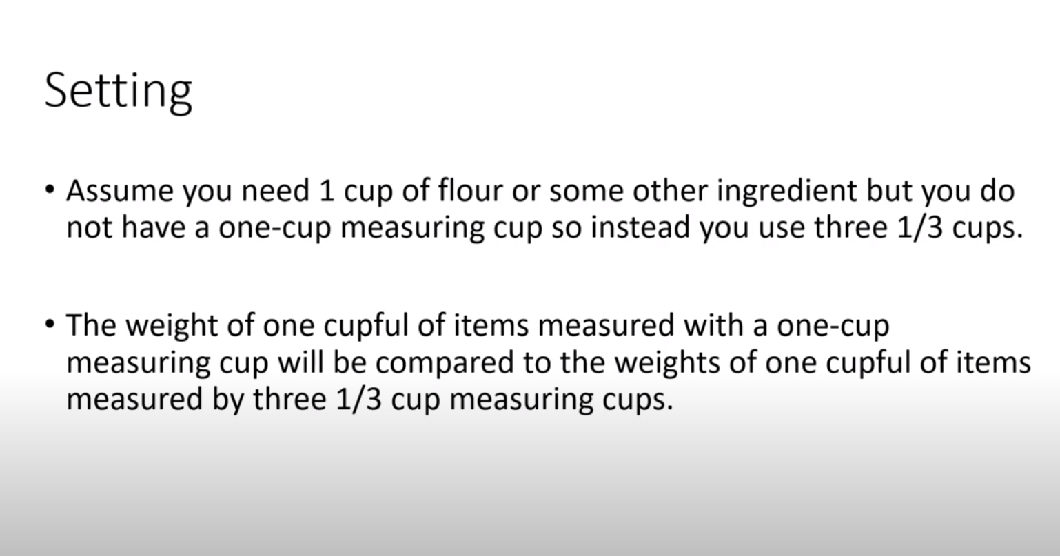

Slide 3
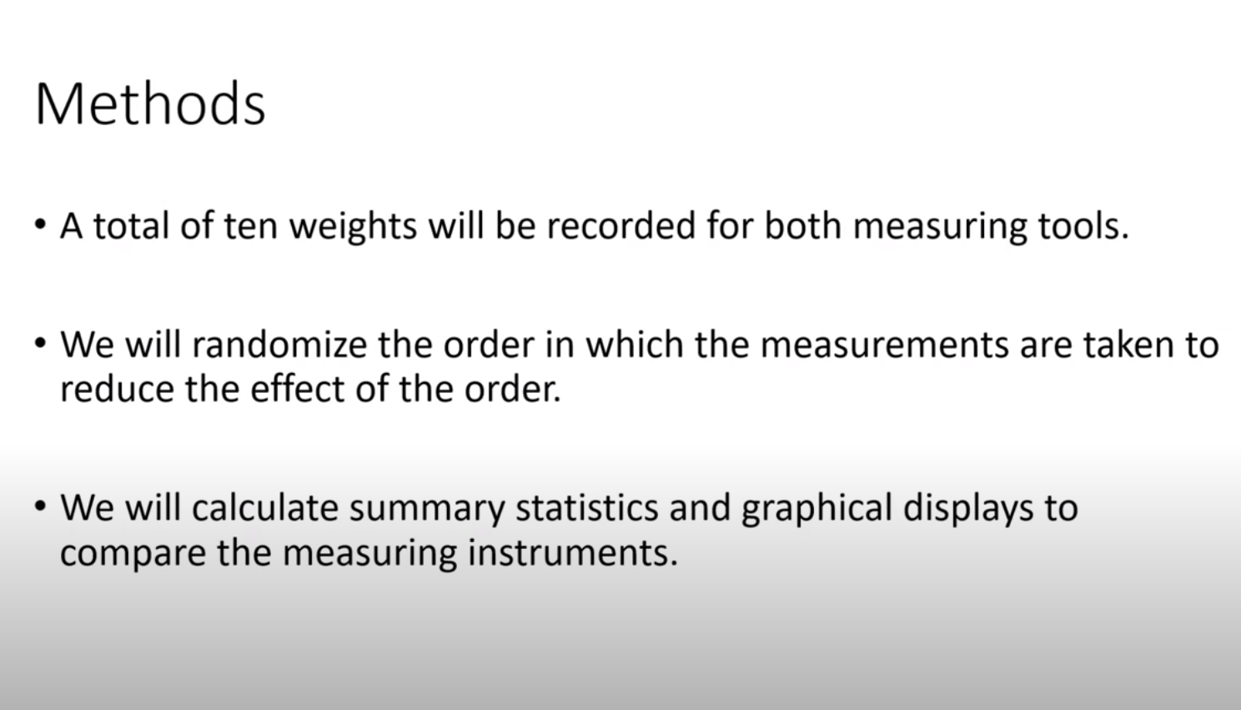

Slide 4
Step 1: Randomize the Order
Steps in StatCrunch: https://www.statcrunch.com/
In VAR1 column 1 => type One 10 times (rows 1 to 10 should have One ). Type Thirds 10 times (rows 11 to 20 should have Thirds).
Data -> Sample ->
Select columns: var 1 (the column you just created)
Sample size: 20
Make sure you do not select “Sample with replacement”
Click Compute
Only fill the Randomized Sequence column of Table 3.2, with the 20 randomized One and Thirds from statcrunch.
Copy the Randomized Sequence column of Table 3.2 to the 2nd column called “Variable” of the Table 3.3.

Slide 5
Step 2: Using the order in table 3.3 start measuring.
Have your two measuring tools ready and measure in unit gram. Denote One as One cup and the other as Thirds ( a one-third measuring cup)
If the first variable in your randomized sequence is ….
One then use your One cup measuring tool to measure the weight of the beads and record measurement.
Thirds then use your One-third cup measuring tool to measure the weight of the beads by adding up the weight of three measurements and record and so on.
Measure all using your One and Thirds tool according to the random order. You will have 20 measurements at the end.
- Do not do all One-cup measuring measurements at once (or vice versa).
Put all the measurements in the 3rd column of the Table 3.3.

Slide 6
Step 3: Calculations by Hand
NOTE THAT YOU DO ONE SET OF CALCULATIONS FOR THE VALUES WITH ONE AND ANOTHER/SEPARATE SET OF CALCULATIONS FOR THE VALUES WITH THIRDS.
From the table 3.3, separate the measurements of the One tool in the 1st column of table 3.4 and the measurements of the Thirds tool in the 1st column of table 3.5.
The following calculations must be done by hand:
Mean.
Standard deviation – note that you must fill out tables 3.4 and 3.5 by hand.
5 number summary. ( Minimum, 1st quartile, median, 3rd quartile , Maximum)
Draw side by side boxplots.

Slide 7
Step 4:
Using the summary statistics you have calculated, and the side-by-side boxplot answer the questions.
Note that Question 8 references the realty check found on the word document.
Each student needs to turn in their own work.

